Slide 1
Nakuja Internship 2026
Solid Propulsion Team
Weekly report #6
Presented by: BenCollins Mureithi
July 24, 2026

Slide 2
Tasks completed this week
Cooking of grains for testing (control grain + suppressant)
One grain static test (surfactant, suppressant)
Old grains disposal
Test stand analysis
3D print igniter circuit cover
5 grain motor design + open rocket simulation
Drafting of a purchase request for second disbursement

Slide 3
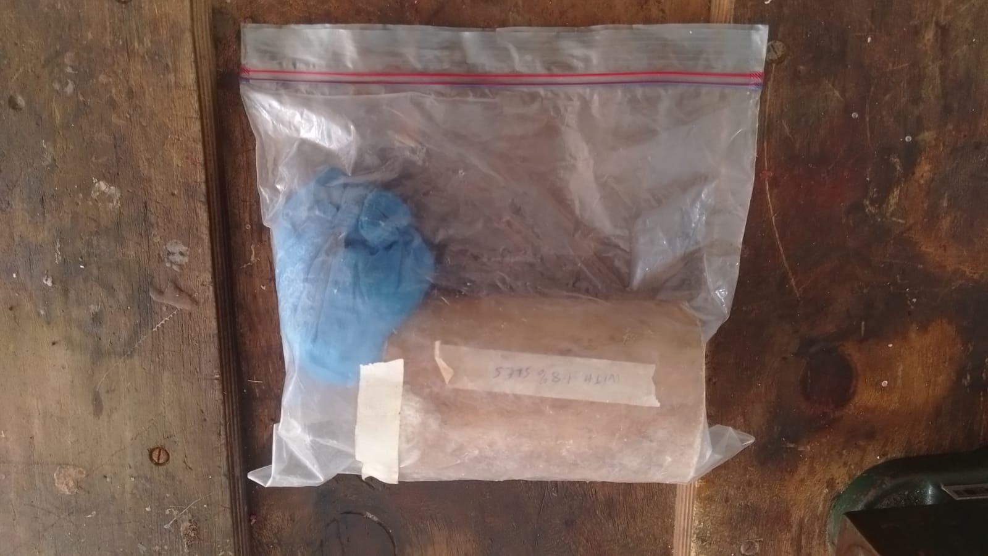
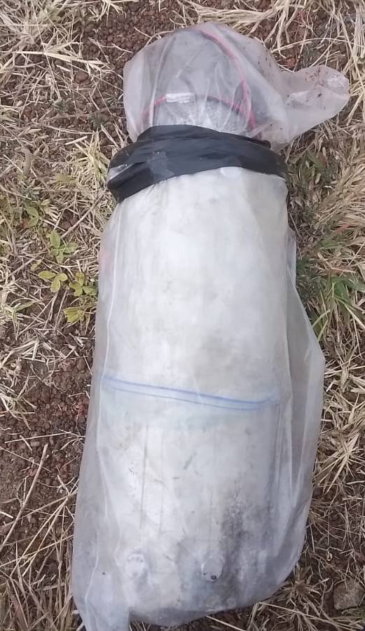
Cooking of propellant grain to be used as control
Purpose: Upon data analysis from the first one grain static test, we discovered an unusually long burn time which is an indicator of moisture presence in the propellant grain. This suggests that the data collected does not reflect the true performance of the grain thus the one grain test for the control grain has to be repeated while preventing moisture entry as our main objective.
Mitigation strategy: After cooking the grain and motor assembly, it shall be stored in a ziplock bag at all times.
Grain during storage: Solid Rocket Motor before static test:

Slide 4
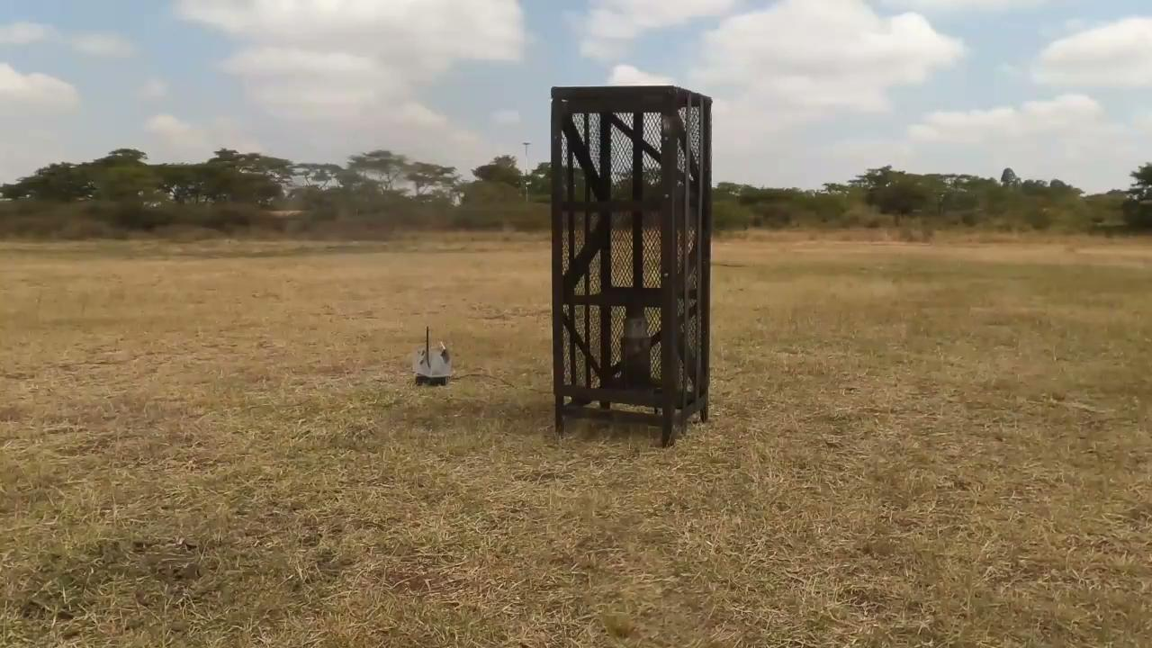
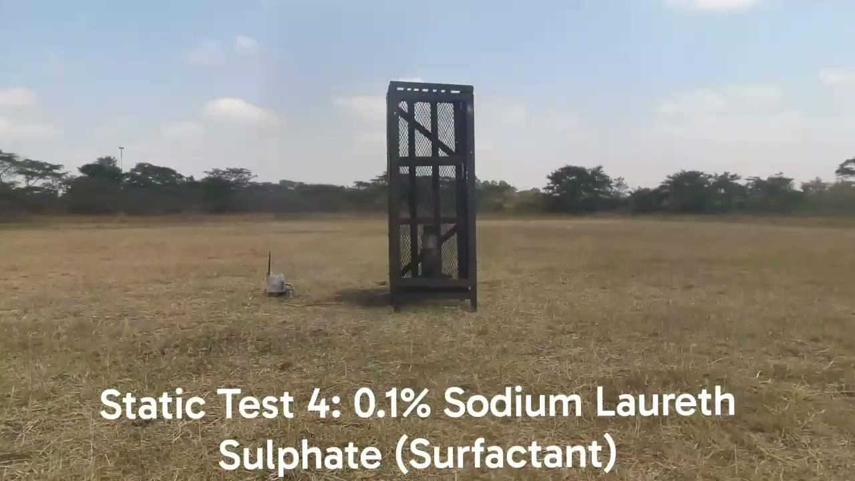
2. One grain static test # 3 & 4 - Addition of surfactant
Purpose: Two one grain static tests were performed for grains containing 1% Sodium Laureth Sulphate (SLES) and 0.1% Sodium Lauryl Sulphate (SLS) in an attempt to mitigate air bubbles and voids, both of which produced similar results. The thrust output from both tests indicate that they cannot be used for motor integration.
Recommendation: SLS or SLES cannot be used for KNSB propellant grains as it suppresses the burn rate which affects the thrust output negatively.
Alternative: Use Lecithin

Slide 5
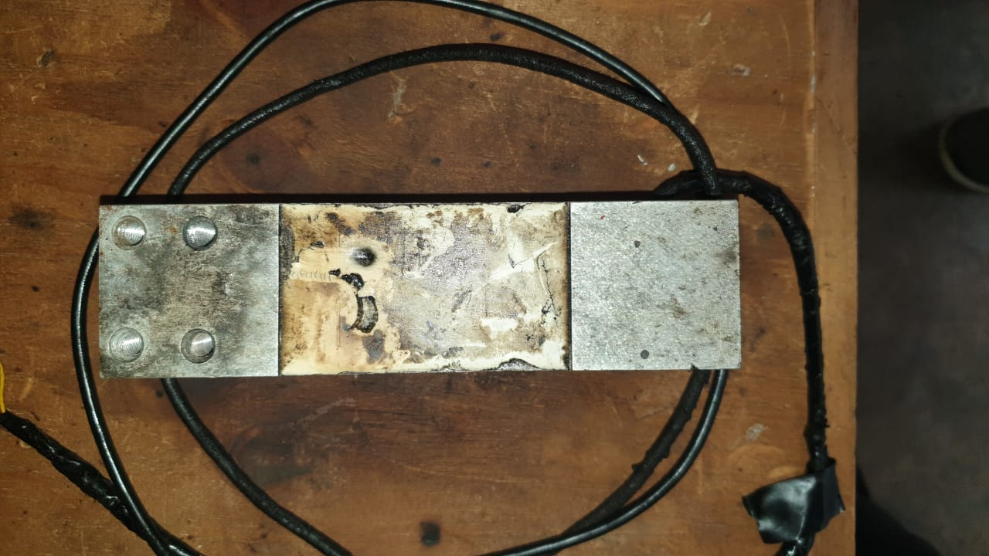
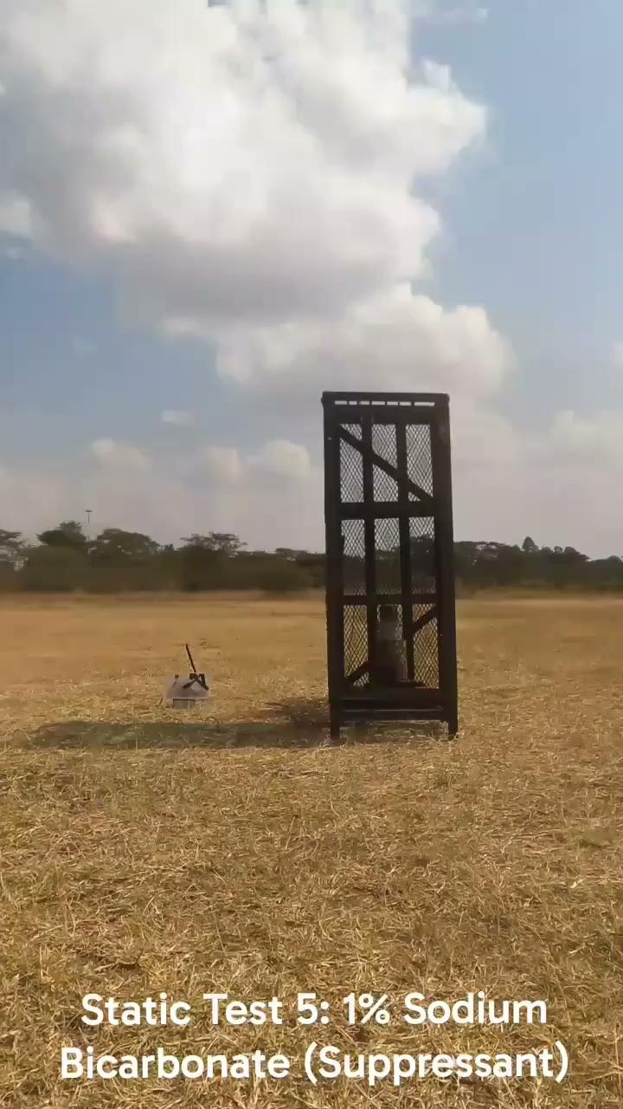
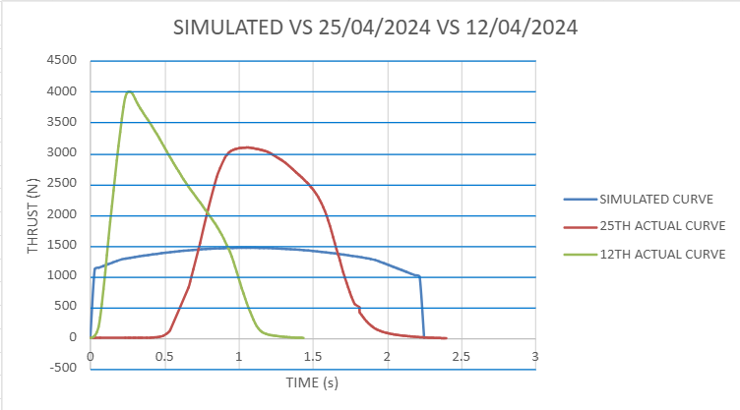
3. One grain static test #5 -Addition of suppressant
Purpose: Upon analysis from previous static tests, we noticed that the actual thrust often exceeds the simulated thrust. To mitigate this observation, we decided to add a suppressant to the KNSB grain.
Challenge encountered: Upon performing the one grain test #5, the test was successful except 1 major issue, due to a faulty load cell, we were not able to retrieve the thrust values generated by the static test. This necessitated purchasing of a new load cell as the one we have has been causing issues all through the test campaign.
Thrust curve from previous tests: Static test video: Faulty load cell:

Slide 6
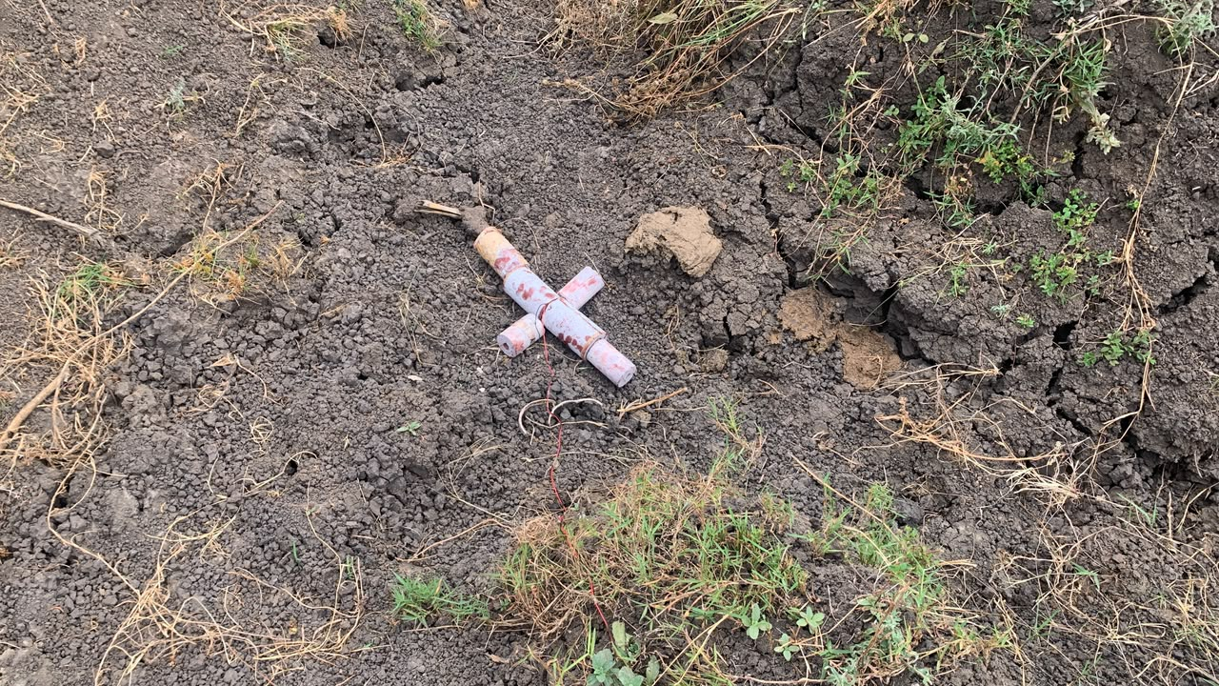
4. Old grains disposal
Purpose: In an attempt to free up the inventory of old grains, the team decided to dispose some of the old propellant grains which were cooked by the previous teams. The grains were disposed remotely in batches of 6 inside a trench located at the baseball pitch at a safe distance of 30m

Slide 7
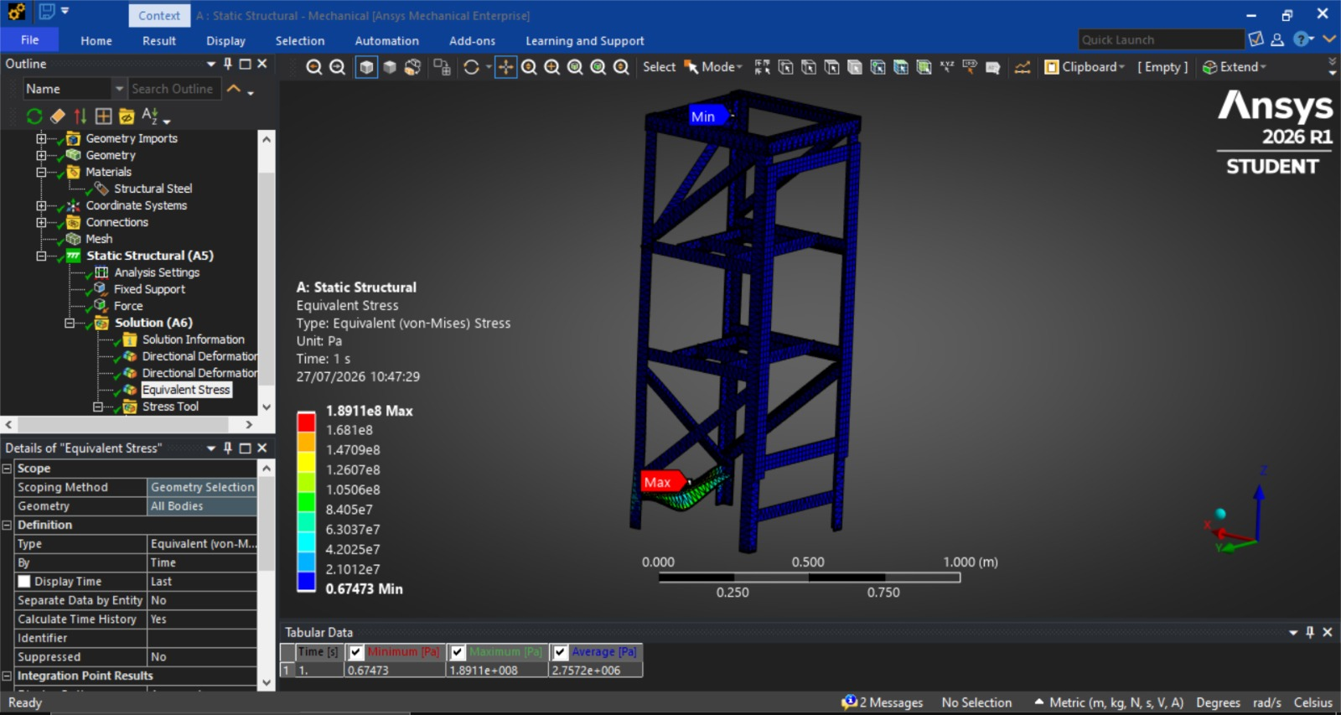
5. Test stand analysis
Purpose:To determine if the test stand could topple in a multi-grain static test. The designer from the previous team said it couldn't as the more the thrust the more stable it gets as its being pressed downward. However, the Load cell support should be reinforced further as the current one yielded in their last five grain test.

Slide 8
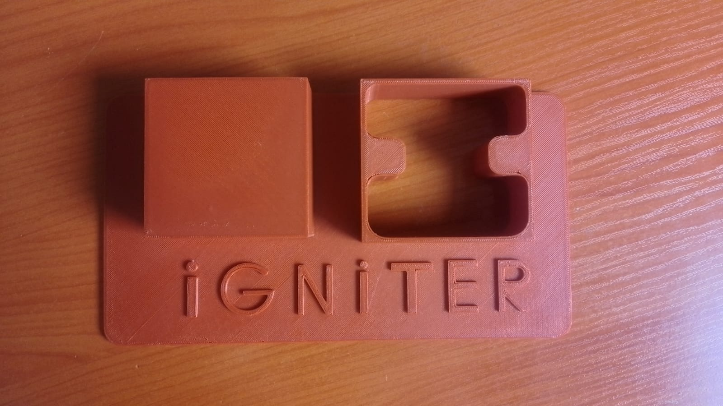
6. 3D printing igniter circuit cover
Purpose: The ignition circuit (trigger and ignitor circuit) fabricated by previous teams did not have any external shielding thus components were exposed to the physical elements which affected the reliability of the circuit as we noticed from the dry runs we conducted. This necessitated design and fabrication of a new case in order to improve the durability and reliability of the ignition circuit system.
Result:

Slide 9
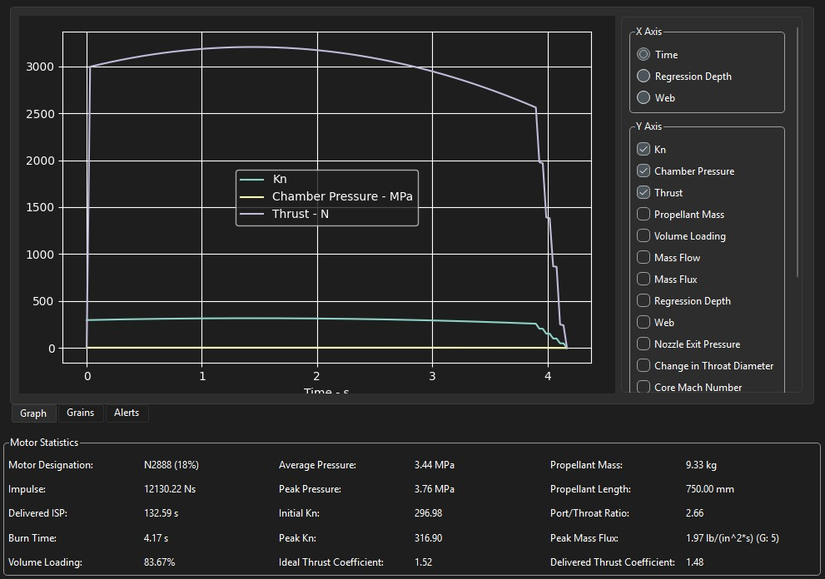
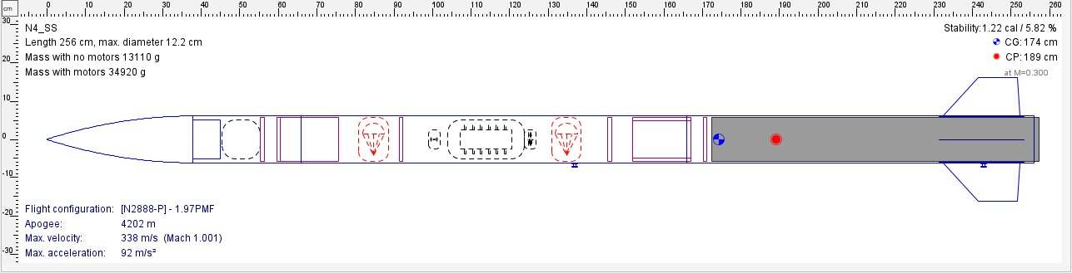
7. 5 grain motor design + open rocket flight simulation
Purpose: In preparation for the 5 grain static test, we had to redesign the 5 grain configuration to fit the new dimensions of the new stainless steel casing.
Major change: Since our current casing has a wider diameter, this has led to a corresponding increase in propellant mass hence thrust, which in turn exceeds our target apogee from 3.5 Km to ~5 Km.
The thrust output of the new SRM cannot be reduced to a four grain as we will not reach the target apogee.

Slide 10
8. Drafting of purchase request for second disbursement
Purpose: As a result of continuous work being done on the project, most consumables i.e Sorbitol, Latex gloves etc have started to get depleted. This has led us to draft a purchase request with proper justification in order to restock some of the utilised materials and also replacement of faulty items.
Link to the new purchase request: https://docs.google.com/spreadsheets/d/1ItQDAlRLaYcg9si493R-wpe7q-Kaqn-85Dn_sr7F3AY/edit?usp=sharing

Slide 11
Next week's tasks
Ignitor preparation and testing
Purchasing of items
One grain static test
Old grains disposal
Liner thickness testing (Burn test)
Load cell sensitivity analysis
3D print trigger circuit casing

Slide 12
Challenges experienced
Faulty load cell led to no data being recorded during the 5th static test
Unavailability of project car led us to use a wheelbarrow to transport the test stand which was tedious.
Supervisors’ note:
Visit Solid Propulsion github projects @ https://github.com/orgs/nakujaproject/projects/26 to review the tasks done.

Slide 13
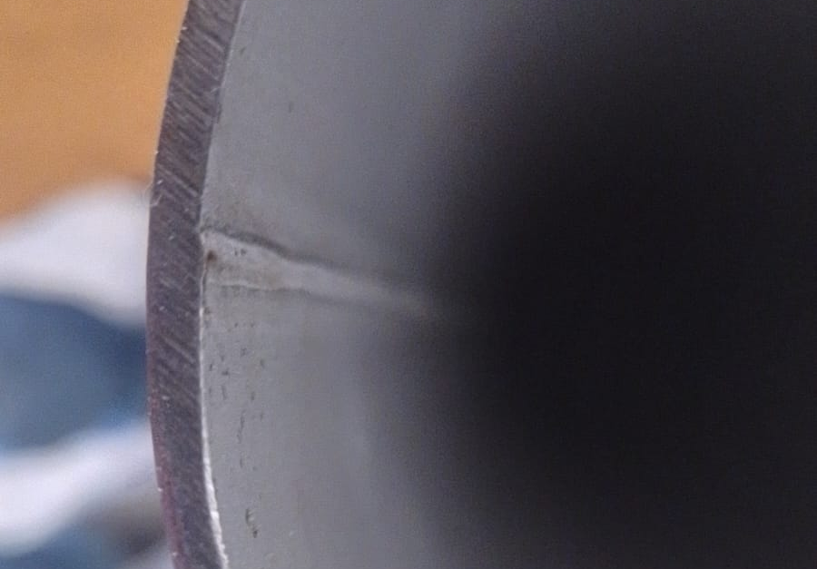
Potential concerns
Team members i.e. Recovery and Solid Propulsion are required to clean their respective working areas (Rapid Prototyping 1 and Exhibition Space) 15 mins before closing time every working day.
The purchased pipe has a ‘flash' which might act as a failure point during the 5 grain static test.

Slide 14
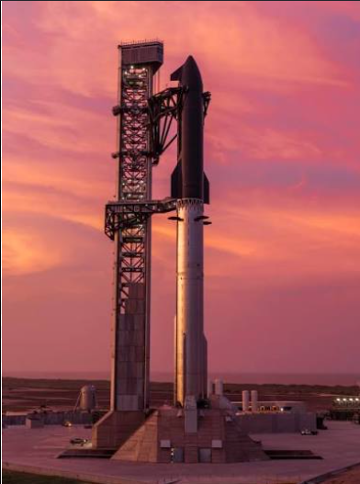
Thank you for your attention!

